Slide 1
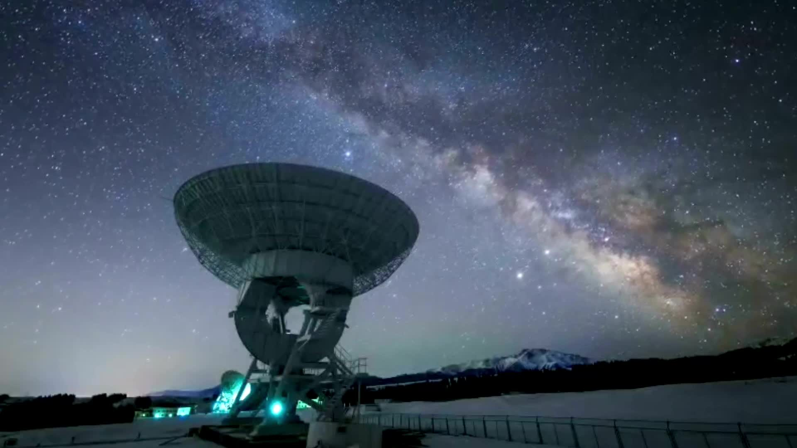
Space Invaders project
By Crystal Sawers

Slide 2
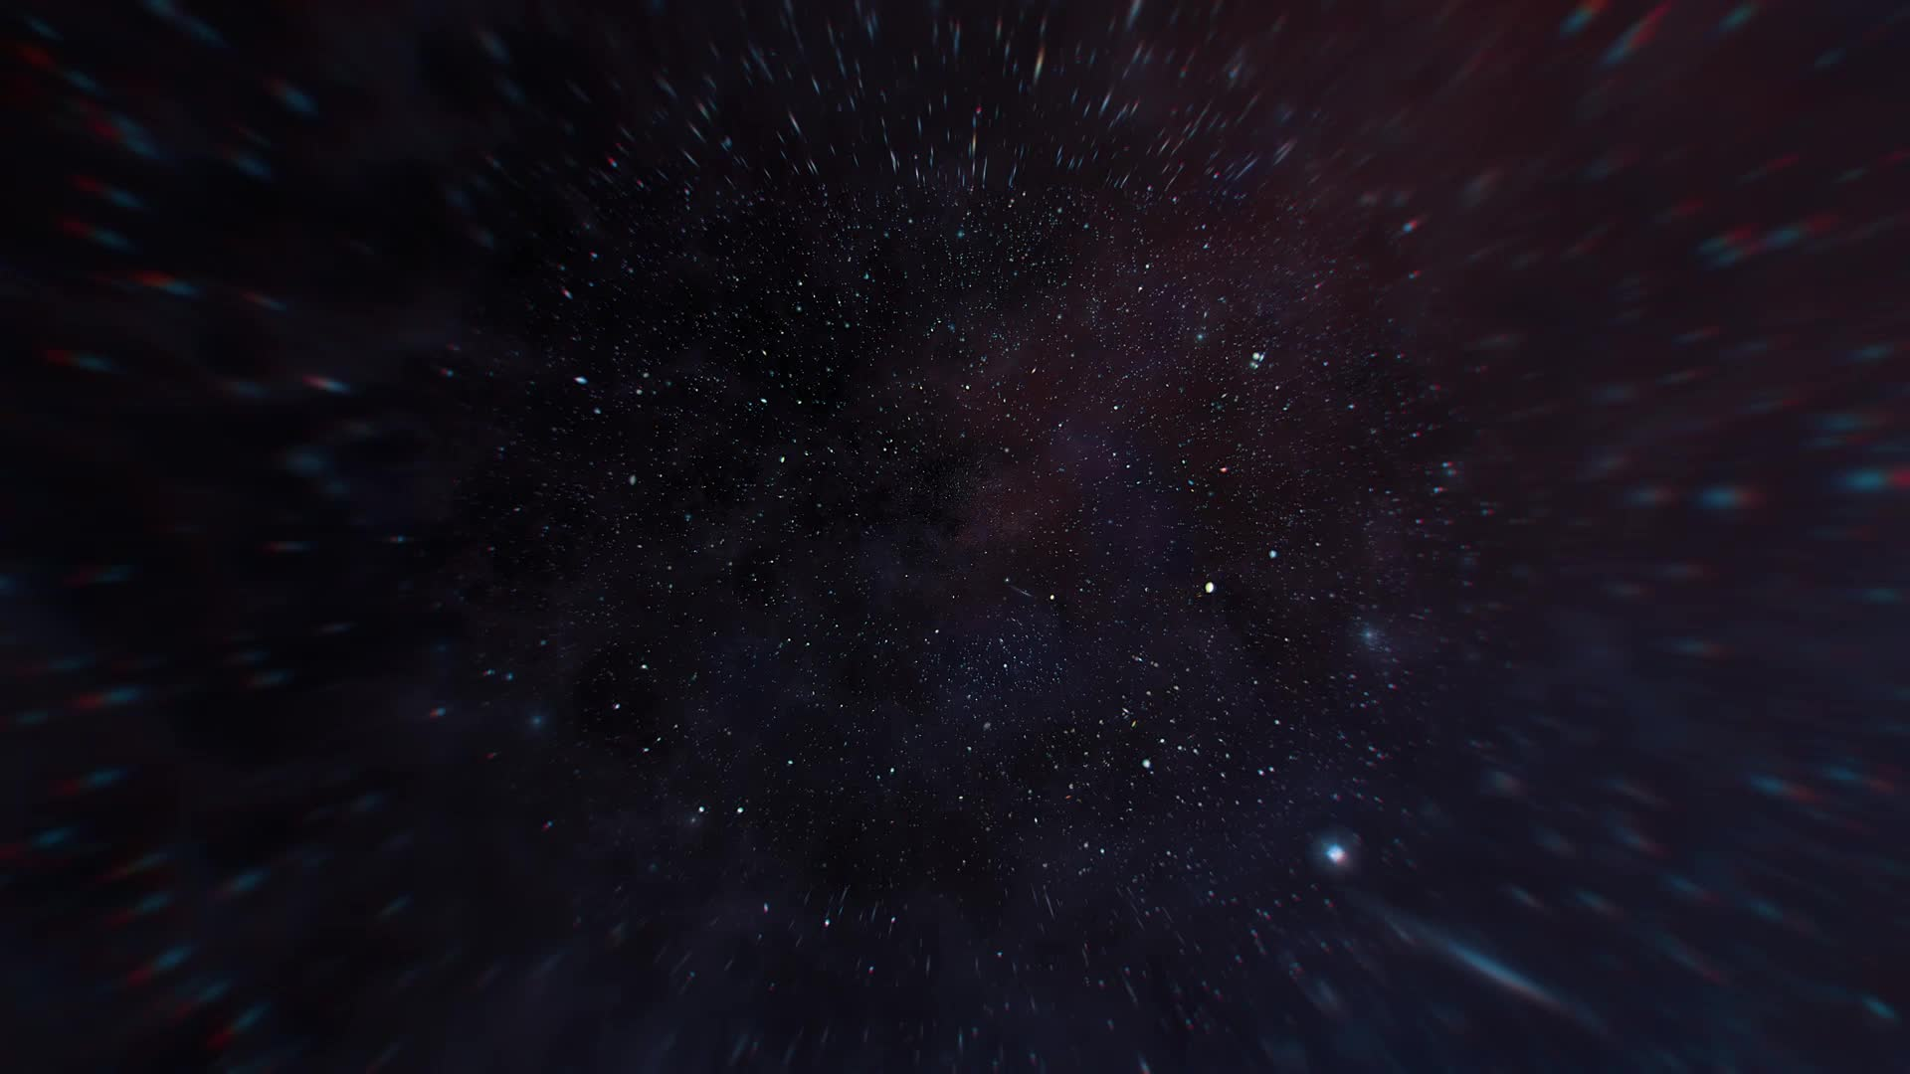
Hardware
- Arduino Uno board
- LCD 128x64 screen (specifically the - ST7920 chipset/controller) : used the u8g2 library, soldered 20 header pins https://www.arduino.cc/reference/en/libraries/u8g2/
- Piezo Buzzer, for sound effects
- Breadboard
- Jumper Wires
- Joystick (specifically wired for only moving horizontally)
- Push button for firing a missile

Slide 3
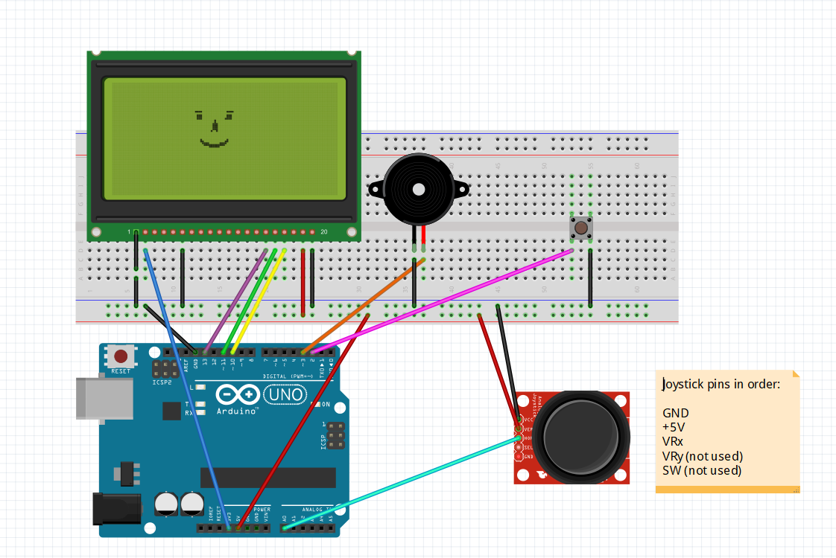
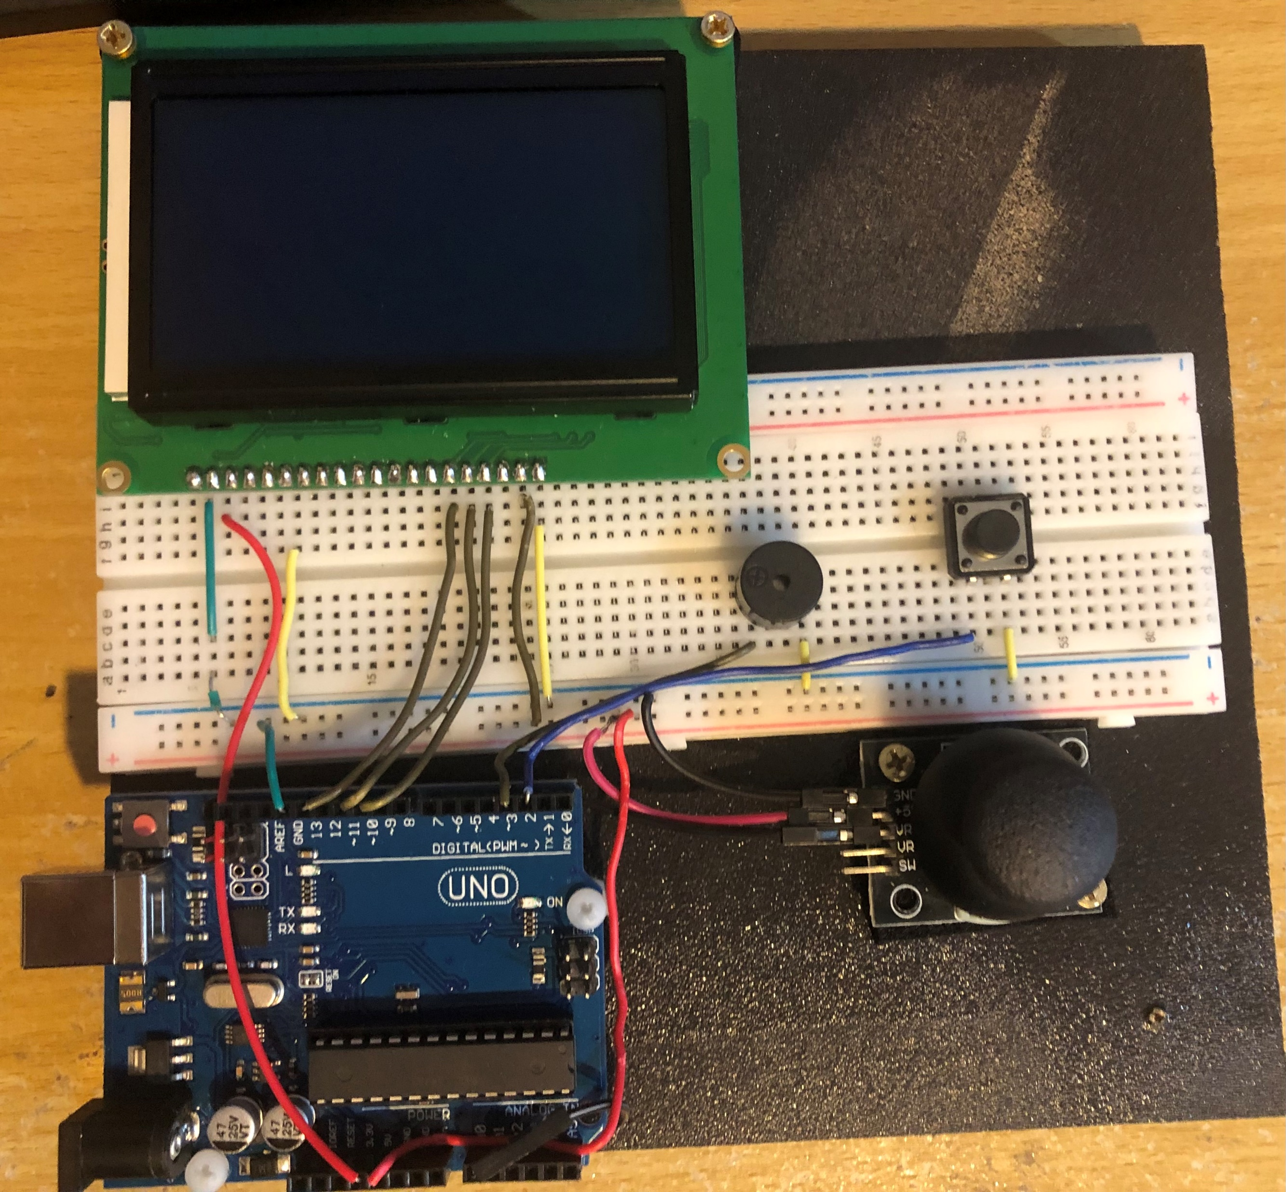
Project design
Circuit diagram from fritzing
Hardware prototype

Slide 4
Project scope
I wanted to create some kind of game in an Arduino form with some type of LCD screen. The goal was to make it as entertaining and engaging as possible with adding some sound, a joystick to move the spaceship, and buttons to fire the missile to hit the alien. The aim of the game is to shoot as many aliens as possible before any of them get to the bottom. There is an unlimited amount of missiles, and at the end of the game it shows whether you win or you lose.

Slide 5
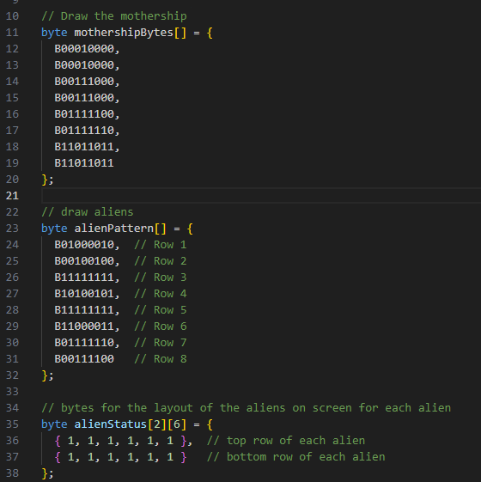
insights
There was a lot more programming involved, so I kept the wiring as simple as possible in terms of functionality.
Created the aliens and the mothership using a byte array with 8 rows of pixels of binary, where 1 is the pixel turned on.
Had a 2d array for the status of each alien
Game over functionality in lcd display for displaying you win or you lose depending on whether all aliens are dead or the aliens touch the mothership (couldn’t completely get the losing part working properly)

Slide 6
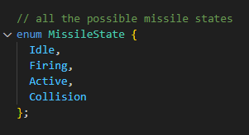
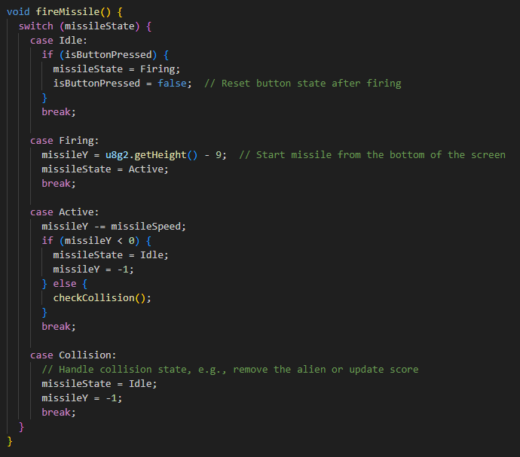
Insights pt. 2
Used a button state for each state of a missile , including when the missile collides with the alien
Had the most of issues with collision detection, (ie. The wrong aliens dying when a missile hits), the you win/you lose (more like where to put it in my code), and everything flickering on the screen
When the game is over, it resets within 5 seconds automatically

Slide 7
Potential improvements
Adding a score system
Fix the aliens touching the mothership
Missile firing button could be less delayed

Slide 8
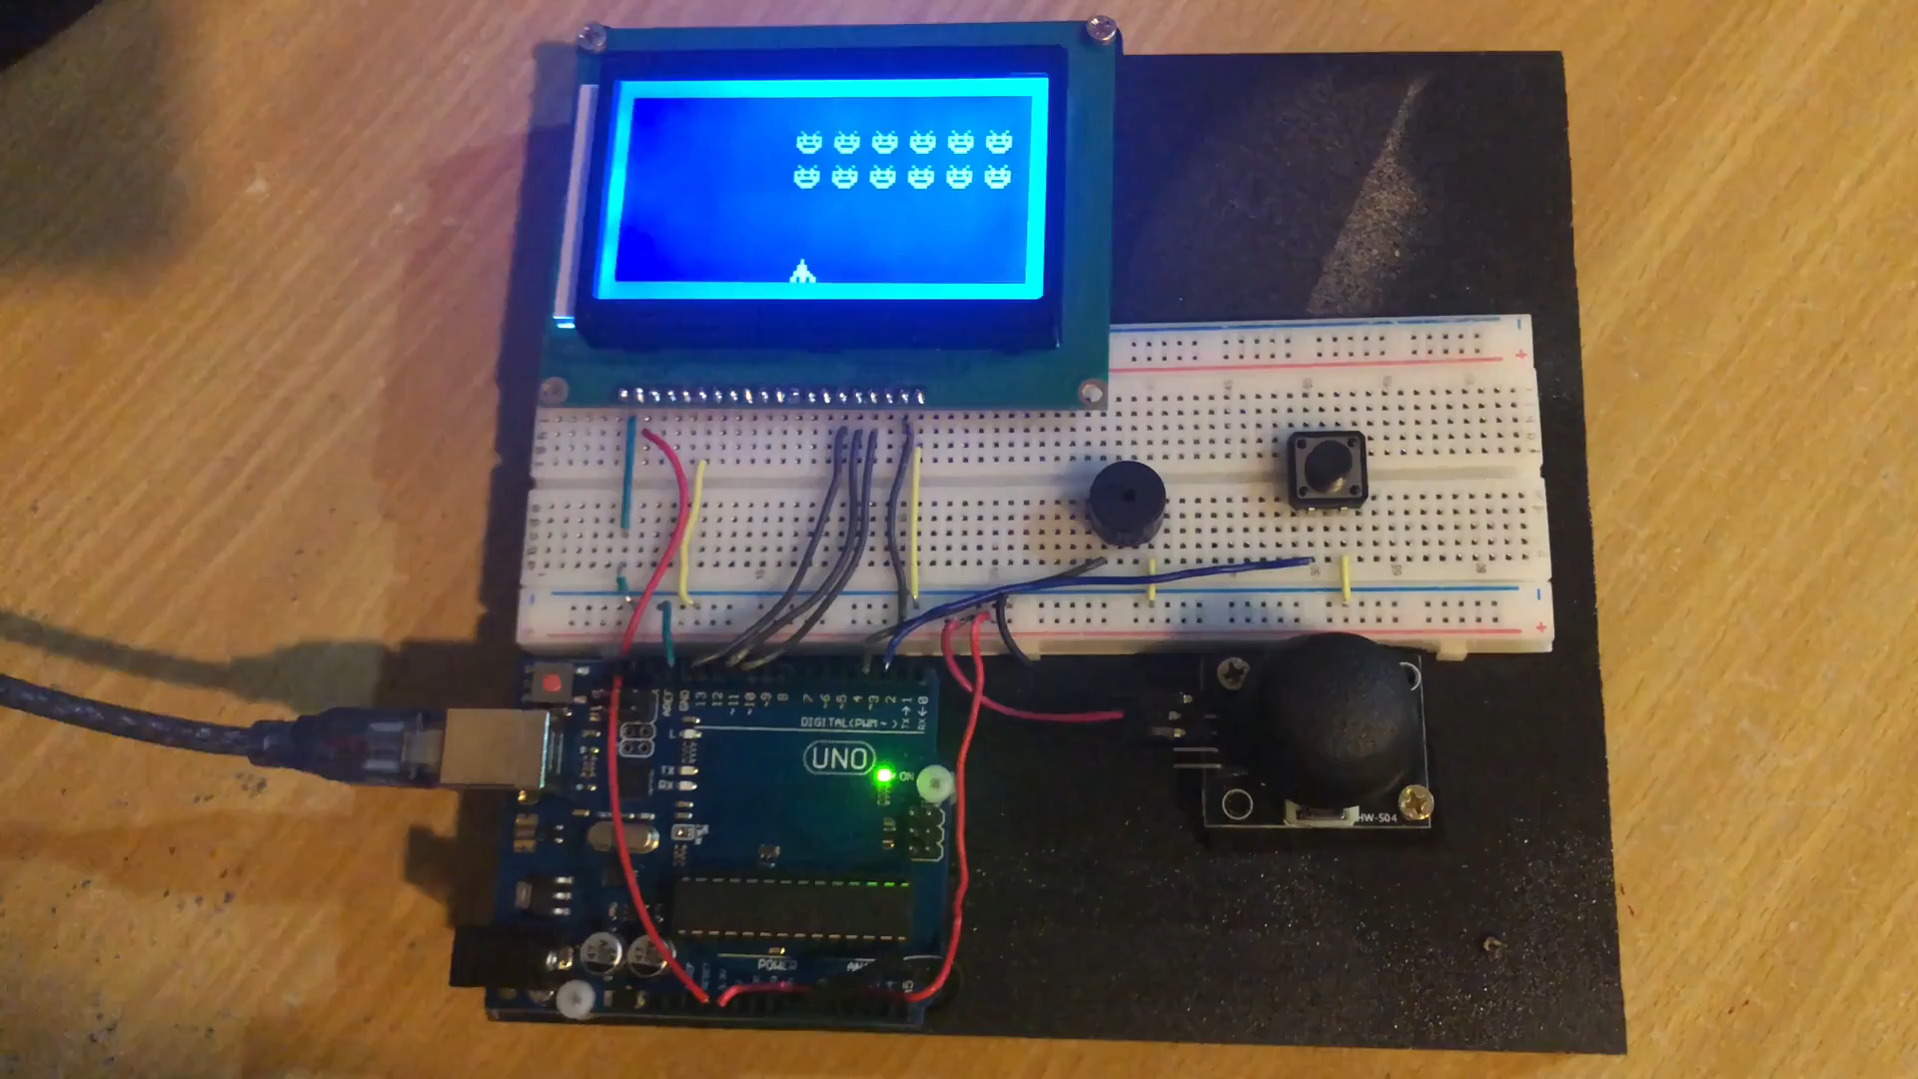
Video Demo

Slide 9
References
Github repo: https://github.com/Crystalsawers/arduino-space-invaders
https://www.instructables.com/LCD-Invaders-a-Space-Invaders-Like-Game-on-16x2-LC/
ChatGPT for the Space invaders idea
https://www.arduino.cc/reference/en/libraries/u8g2/
https://github.com/rmorenojr/SpaceInvaders_U8g2/blob/master/SpaceInvaders_U8g2.ino
Setup reference: https://github.com/olikraus/u8g2/wiki/u8g2setupcpp#st7920-128x64

